Slide 1
AI based motion control detail algorithm of trajectory-based motion control
1.21 Jin Lexuan

Slide 2
General algorithm
1.path plan and trajectory calculation for 2 UAVs
(since get trajectory, means for each UAV, its location of each second is known.)
2.For every second, calculate the distance of two UAVs
3.if the distance is larger that the set collision circle
no collision, keep two trajectory
else:
high priority UAV keeps original trajectory, replan trajectory of lower priority UAV: slow down the velocity of low priority UAV, make sure in new trajectory, it pass the collison point when high priority UAV passed

Slide 3
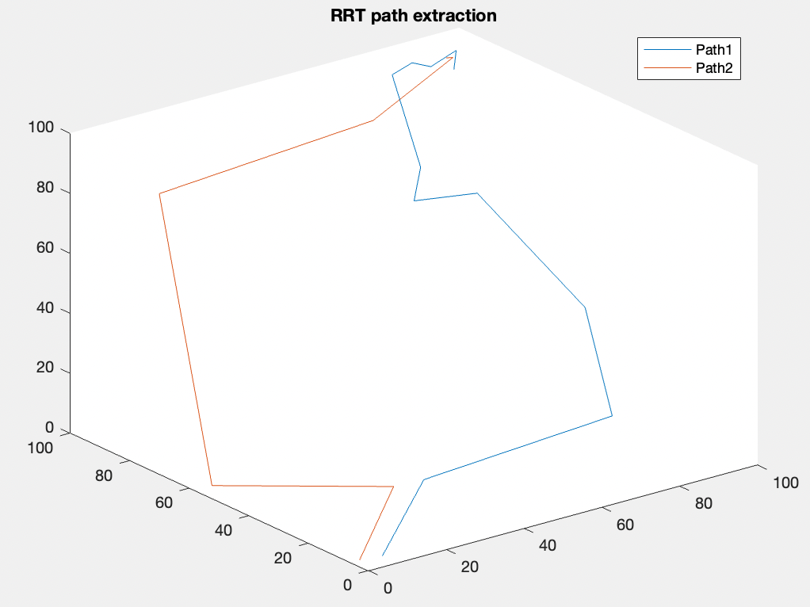
Path to Keypoint
There are two path generated by RRT in the picture. For each part, it is divided into several smaller path by keypoints(as 1,2,3,4,5...), according to the changing of direction.
5
4
3
2
1

Slide 4
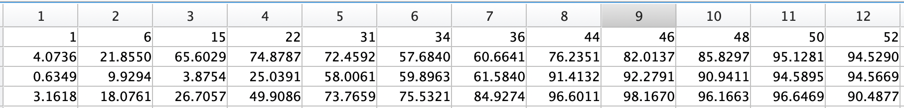
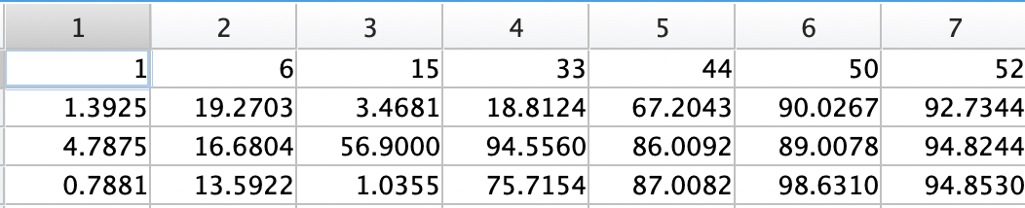
Time and location of two UAVs at keypoints:
Keypoint1
keypoint
time
x-position
y-position
z-position
Keypoint2
keypoint
time
x-position
y-position
z-position
Transfer keypoint to trajectory

Slide 5
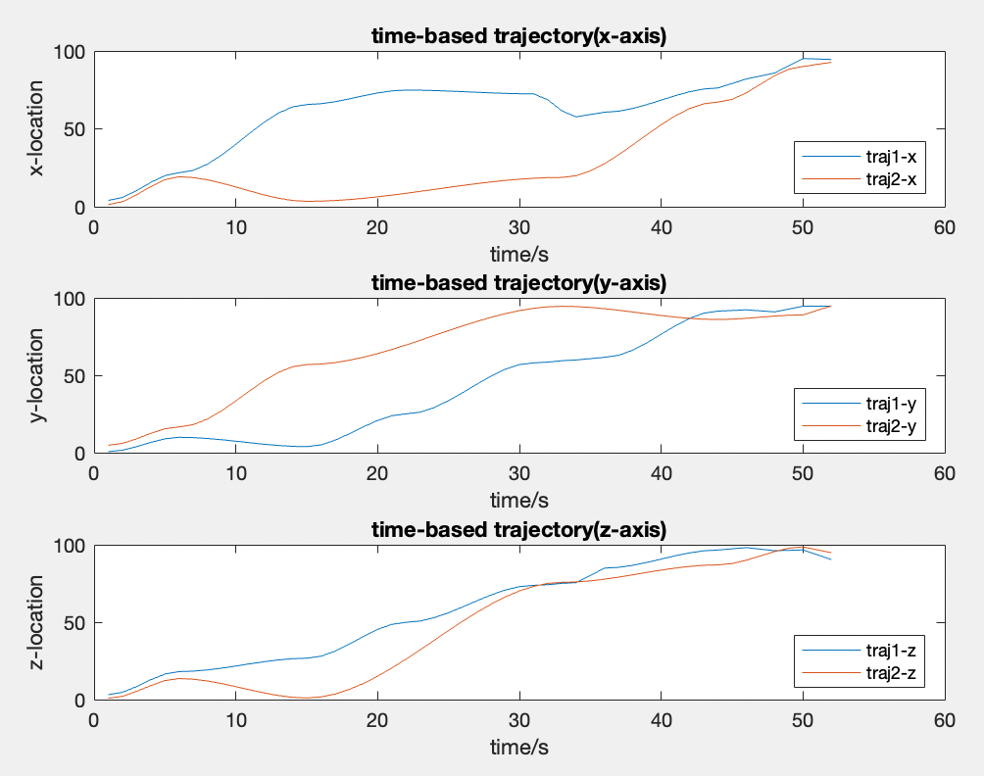
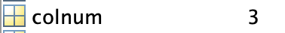
Tajectory(Position of each second)
From two trajectory, we can calculate the distance of UAVs for each second, if the distance is smaller than the collision threshold, it will be detected and the time will be recorded.
In this example, collision will happen in
From left image, it shows at 48s,49s,52s, two UAVs are very close to each other.
colnum shows how many collision will happen

Slide 6
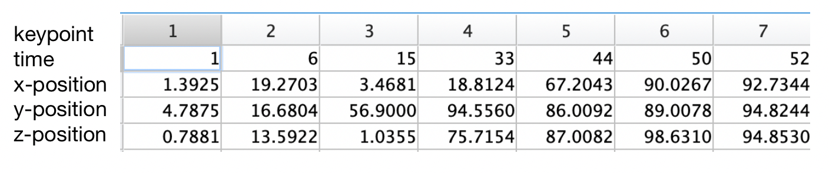
Slow down one trajectory but not stop
52
55
Since the collision happens at 48s, 49s and 52s, so it will affects keypoint5 to keypoint6 and keypoint6 to keypoints7 this two part. Keypoint1 to keypoint5 will not be influenced.
The method to slow down trajectory:
48 and 49 are included to [44,50] this interval, so the interval will be increased by two seconds
The new time period of keypoint5 to keypoint6 will be [44,52]
This will also affect the next period so it becomes [52, 54] from original[50,52]
And another collsion time is 52 it will affect the [52,54] interval, so this inverval will be increased by one second. The new time period of keypoint6 to keypoint1 will be [52,55]
Then all the collision time is considered, the new trajectory is generated.

Slide 7
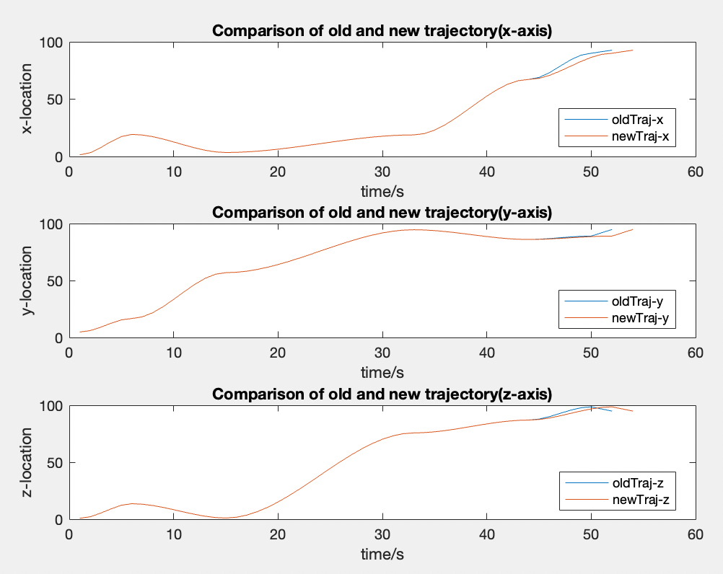
Comparision of old and new trajectory
The orange one is the new trajectory and the blue one is the old trajectory. It shows that the difference starts at 44s (keypoint5), and the new trajectory finished the path 3 seconds slower than the old one.

Slide 8
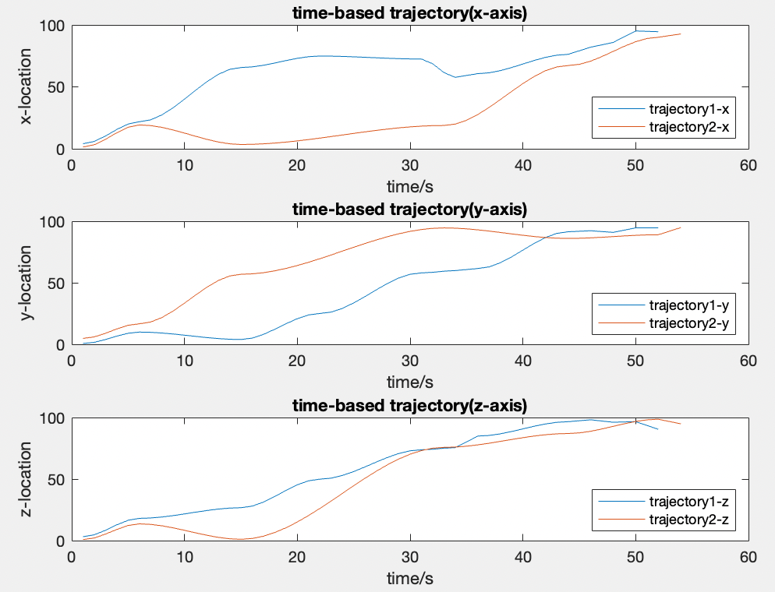
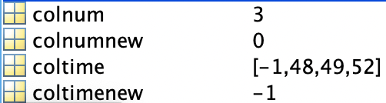
Comparison of trajectory1 and new Trajectory2
New trajectory2 is slower to avoid collison, It let trajectory1 to finish the path in advance.
For collision detection part, it shows there will be no collision for two trajectory

Slide 9
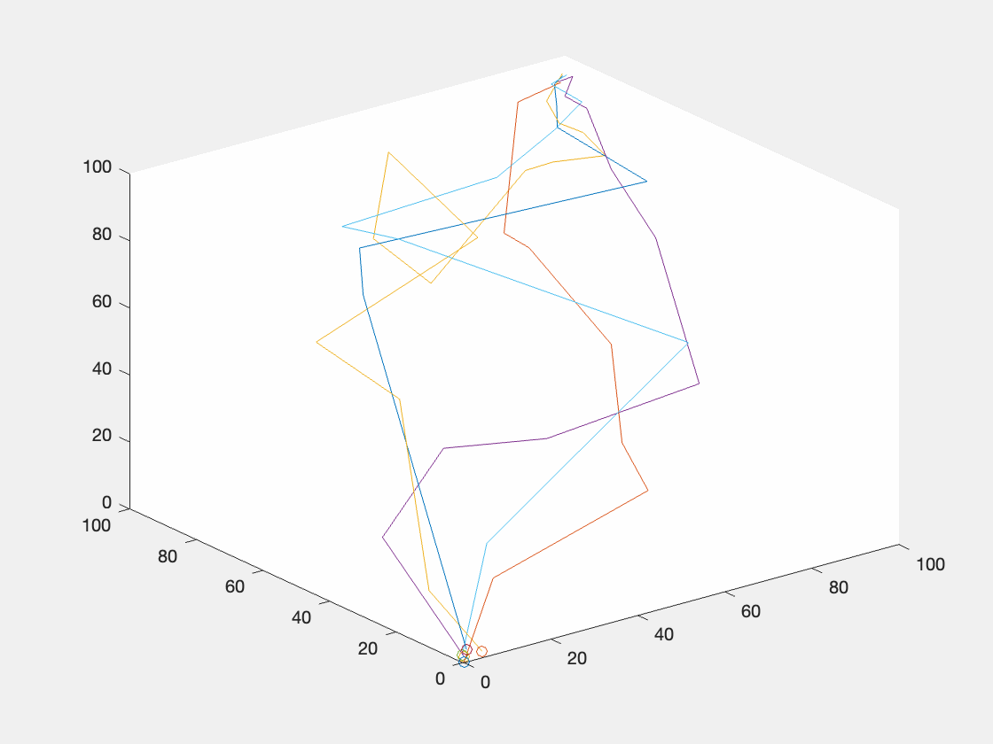
Save Trajectory as Gif
for each second, draw each UAV's position in the picture, then save it as a frame of GIF

Slide 10
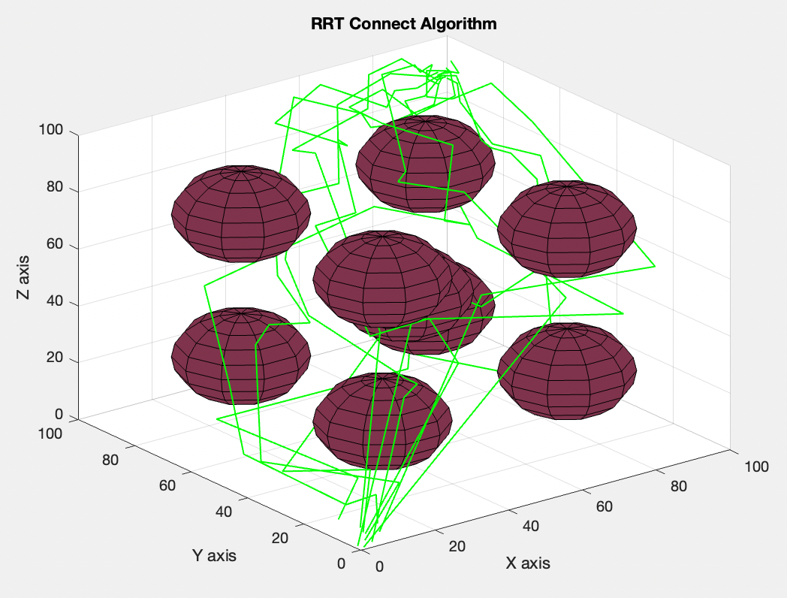
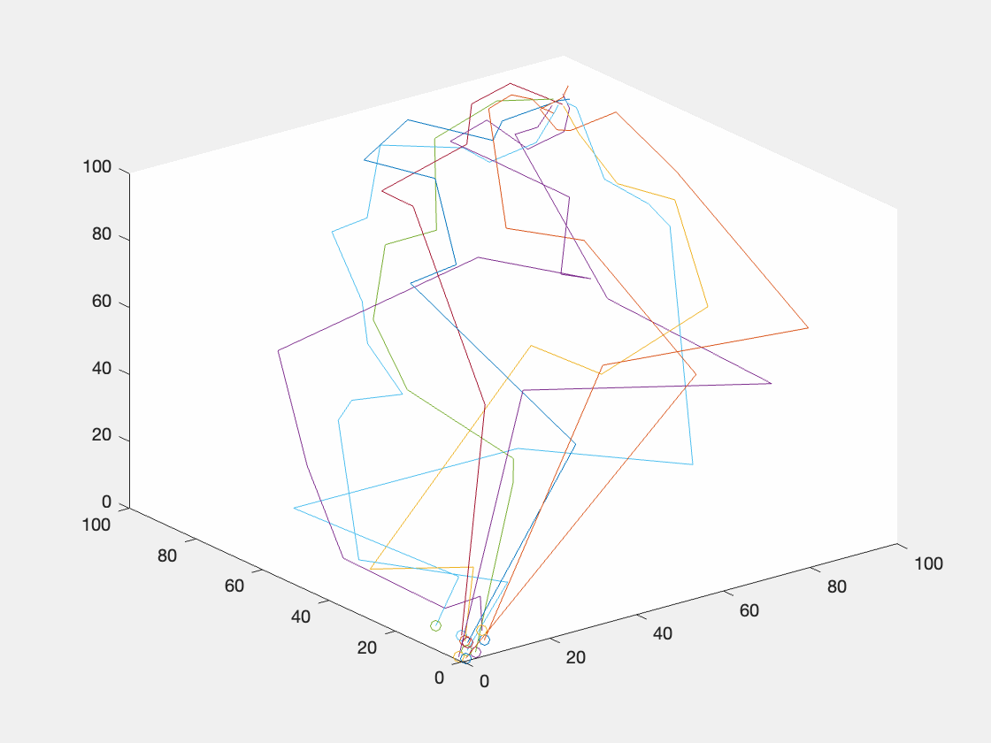
10 UAVs

Slide 11
Future work
Change RRT map: Now the 3D map is small for over 5 UAVs,collision happens easily, so enlarging map is necessary to allow more UAVs
Make more GIF to show the whole process and make it more clear

